Slide 1
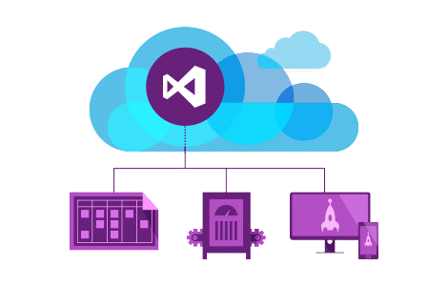
Razor Views
Views, Razor Syntax, Layout, Tag Helpers, View Components
SoftUni Team
Technical Trainers
Software University
https://softuni.bg

Slide 2
Table of Contents
View Engine Essentials
Razor Syntax
Dependency Injection
Layout and Special View Files
_Layout, _ViewStart, _ViewImports and Sections
HTML Helpers & Tag Helpers
Partial Views & View Components

Slide 3
Have a Question?
sli.do #csharp-web

Slide 4

View Engine Essentials

Slide 5
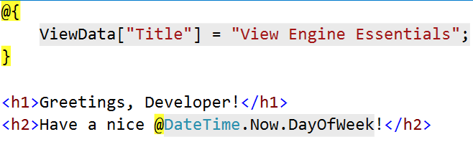
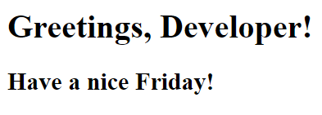
View Engine Essentials
Views in ASP.NET Core MVC use the Razor View Engine to embed .NET Code in HTML Markup.
Usually, they contain minimal logic, related only to presenting data
Data can be passed to a View by using the ViewData, ViewBag or through a ViewModel (Strongly-Typed View).

Slide 6

Passing Data to a View
With ViewBag (dynamic type):
Action: ViewBag.Message = "Hello World!";
View: @ViewBag.Message
With ViewData (dictionary)
Action: ViewData["message"] = "Hello World!";
View: @ViewData["message"]
With Strongly-typed views:
Action: return View(model);
View: @model ModelDataType and then @Model.Message

Slide 7
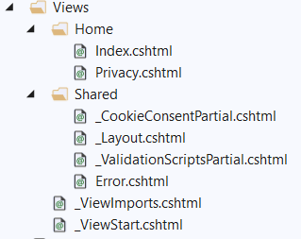
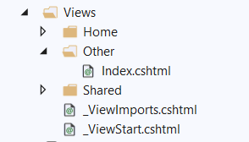
Returning Views
The Base Controller class provides a lot of functionality
View() method – One of the most frequently used Controller class members
public class HomeController : Controller {
public IActionResult Index()
{
return this.View();
}
}
public IActionResult Index()
{
return
this.View("~/Views/Other/Index.cshtml");
}

Slide 8
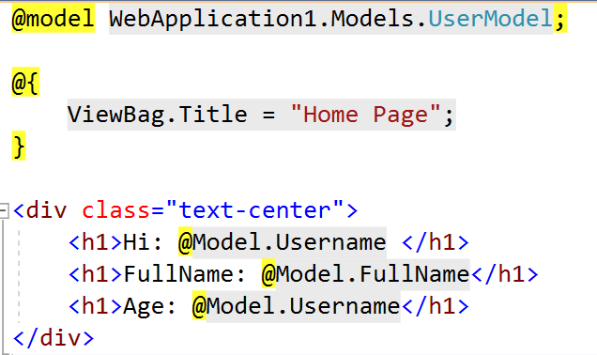
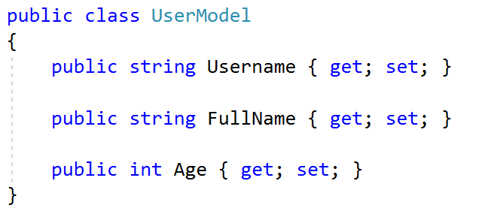
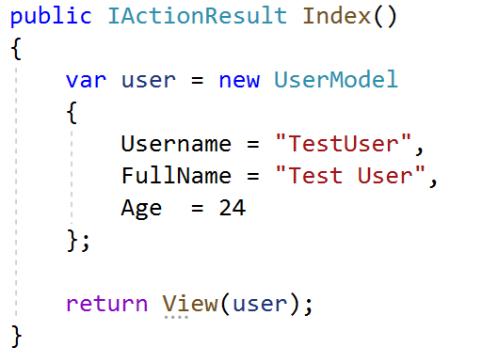
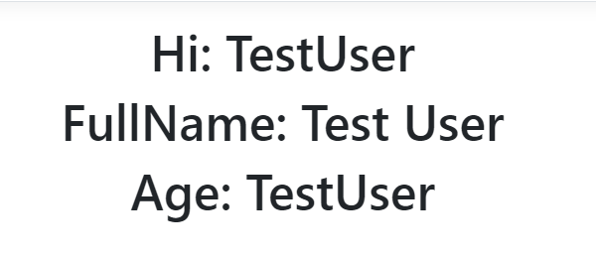
How It Works?
View
ViewModel
Controller
Generated Output

Slide 9

Razor Syntax

Slide 10
Razor Syntax (1)
@ – For values (HTML encoded)
@{ … } – For code blocks (keep the view simple!)
<p>
Current time is: @DateTime.Now!!!
Not HTML encoded value: @Html.Raw(someVar)
</p>
@{
var productName = "Energy drink";
if (Model != null) { productName = Model.ProductName; }
else if (ViewBag.ProductName != null) { productName = ViewBag.ProductName; }
}
<p>Product "@productName" has been added in your shopping cart</p>

Slide 11
Razor Syntax (2)
If, else, for, foreach, etc. C# statements
HTML markup lines can be included at any part
@: – For plain text line to be rendered
<div class="products-list">
@if (Model.Products.Count() == 0) { <p>Sorry, no products found!</p> }
else
{
@:List of the products found:
foreach(var product in Model.Products)
{
<b>@product.Name, </b>
}
}
</div>

Slide 12
Razor Syntax (3)
Comments
What about "@" and emails?
@*
A Razor Comment
*@
@{
// A C# comment
/* A Multi
line C# comment
*/
}
<!-- HTML Comment -->
<p>
This is the sign that separates email names from domains: @@<br />
And this is how smart Razor is: spam_me@gmail.com
</p>

Slide 13
Razor Syntax (4)
@(…) – Explicit code expression
@using – for including namespace into view
@model – for defining the model for the view
<p>
Current rating(0-10): @Model.Rating / 10.0 @* 6 / 10.0 *@
Current rating(0-1): @(Model.Rating / 10.0) @* 0.6 *@
spam_me@Model.Rating @* spam_me@Model.Rating *@
spam_me@(Model.Rating) @* spam_me6 *@
</p>
@using MyFirstMvcApplication.Models;
@model UserModel
<p>@Model.Username</p>

Slide 14
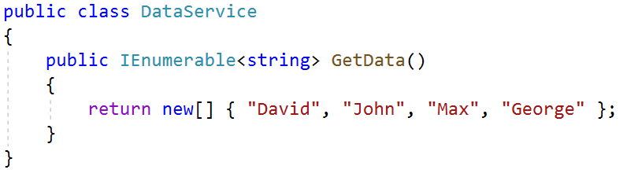
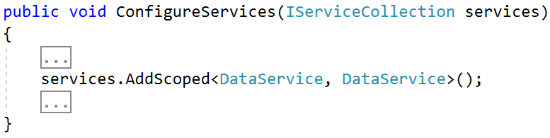
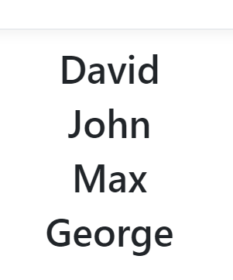
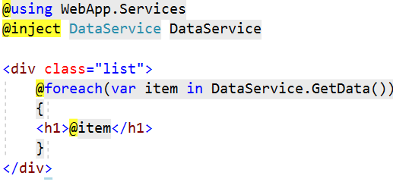
Views – Dependency Injection
ASP.NET Core supports dependency injection into views.
You can inject a Service into a View by using @inject

Slide 15
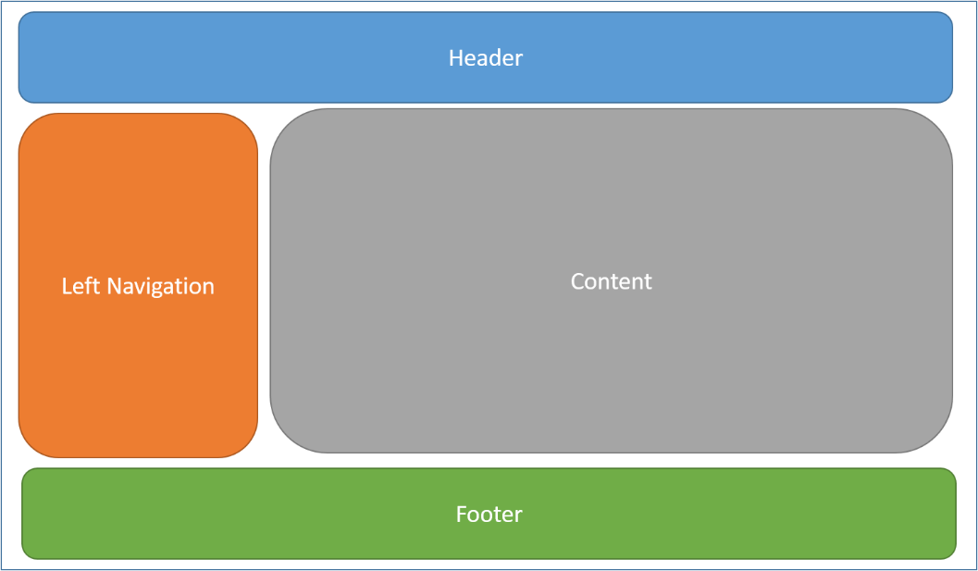
Layout and Special View Files

Slide 16
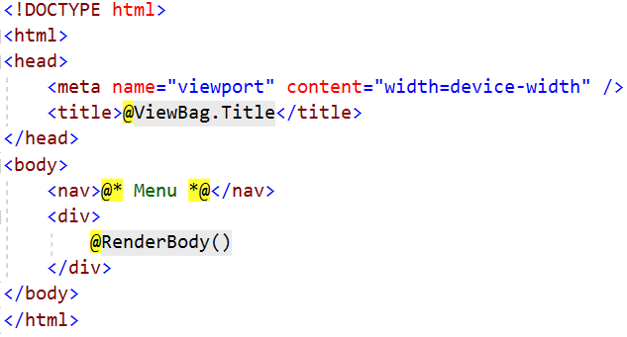
Layout
Define a common site template (~/Views/Shared/_Layout.cshtml)
Razor View engine renders content inside-out
First the View is rendered, and after that – the Layout
@RenderBody() – indicate where we want the views based on this layout to "fill in" their core content at that location in the HTML

Slide 17
_ViewStart.cshtml
Views don't need to specify layout since their default layout is set in their _ViewStart file:
~/Views/_ViewStart.cshtml (code for all views)
Each view can specify custom layout pages
Views without layout:
@{
Layout = "~/Views/Shared/_UncommonLayout.cshtml";
}
@{
Layout = null;
}

Slide 18
_ViewImports.cshtml
If a directive or a dependency is shared between many Views it can be specified globally in the ViewImports:
~/Views/_ViewImports.cshtml (code for all views)
This file does not support other Razor features
@using WebApplication1
@using WebApplication1.Models
@using WebApplication1.Models.AccountViewModels
@using WebApplication1.Models.ManageViewModels
@using Microsoft.AspNetCore.Identity
@addTagHelper *, Microsoft.AspNetCore.Mvc.TagHelpers

Slide 19
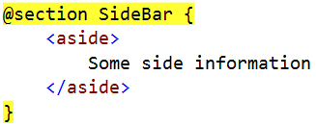
Sections
You can have one or more "sections" (optional)
They are defined in the views:
Can be rendered anywhere in the layout page using the method RenderSection()
@RenderSection(string name, bool required)
If the section is required and not defined, an exception will be thrown (IsSectionDefined())

Slide 20
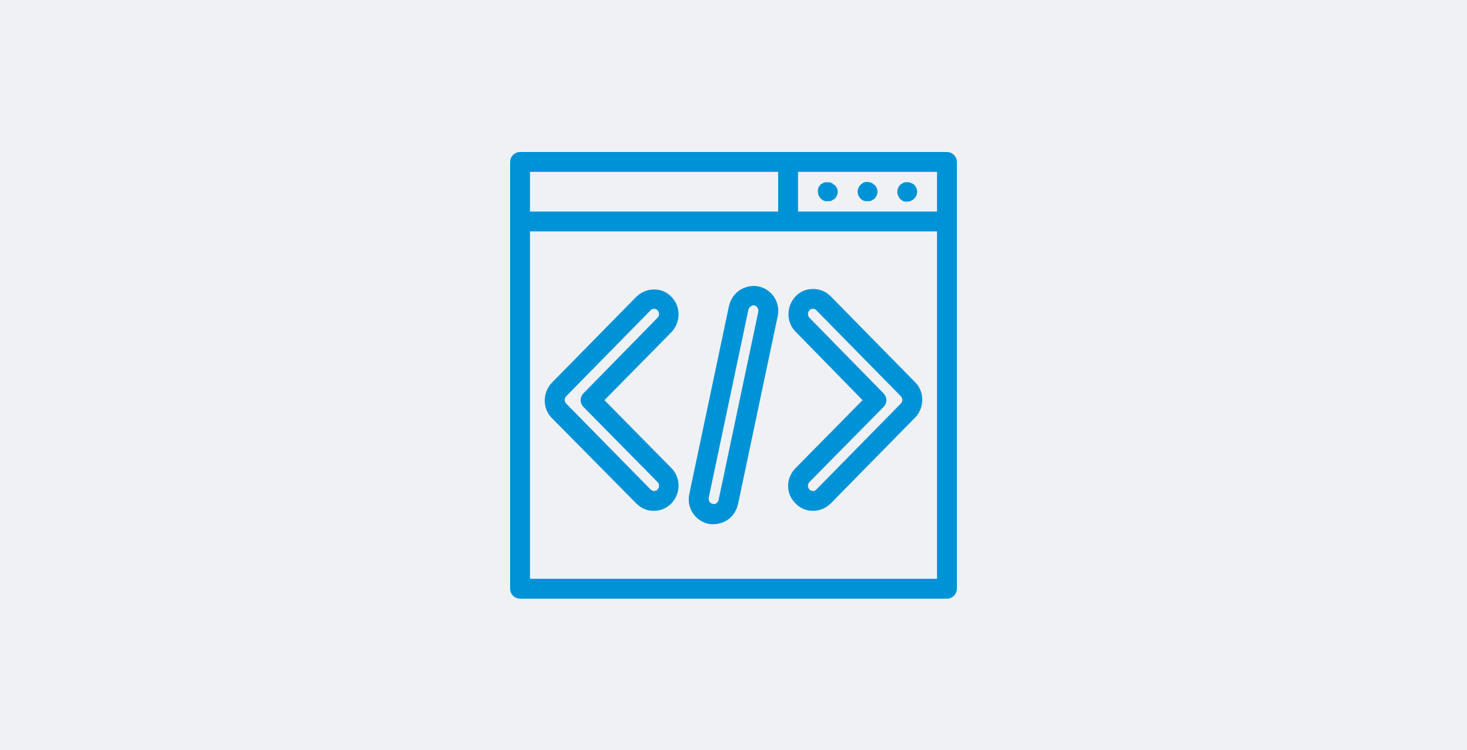
HTML Helpers and Tag Helpers

Slide 21
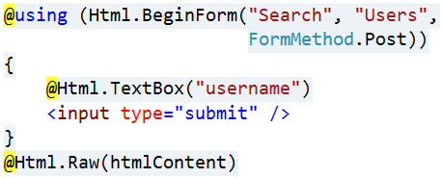
HTML Helpers
Each view inherits RazorPage
RazorPage has a property named Html
The Html Property has methods that return string can be used to:
Create inputs
Create links
Create forms
Avoid using HTML Helpers
Use Tag Helpers instead
HTML Helpers
@Html.ActionLink | @Html.TextBox
@Html.BeginForm | @Html.TextArea
@Html.CheckBox | @Html.Password
@Html.Display | @Html.Hidden
@Html.Editor | @Html.Label
@Html.DropDownList | @Html.Action

Slide 22


Tag Helpers
Tag Helpers enable the participation of Server-side code in the HTML element creation and rendering, in Razor views
There are built-in Tag Helpers for many common tasks
Forms, Links, Assets etc.
There are custom Tag Helpers in GitHub repos and NuGet
Tag Helpers provide
An HTML-friendly development experience
A rich IntelliSense environment for creating Razor markup
A more productive, reliable and maintainable code

Slide 23
Tag Helpers vs HTML Helpers (1)
Tag Helpers attach to HTML elements in Razor Views
Tag Helpers reduce the explicit transitions between HTML & C#
Tag Helpers make the Razor markup quite clean and the views – quite simple
HTML Helpers are invoked as methods which generate content
HTML Helpers tend to include a lot of C# code in the markup
HTML Helpers use complex and very C#-specific Razor syntax in some cases

Slide 24
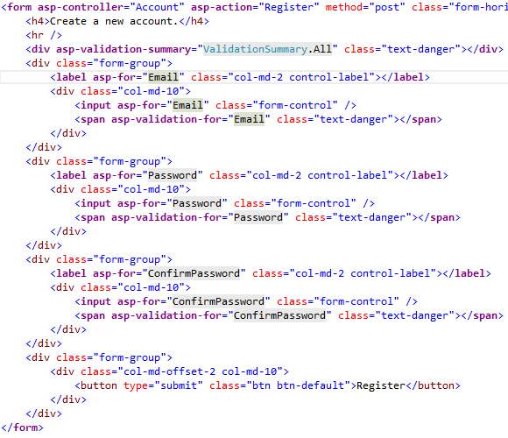
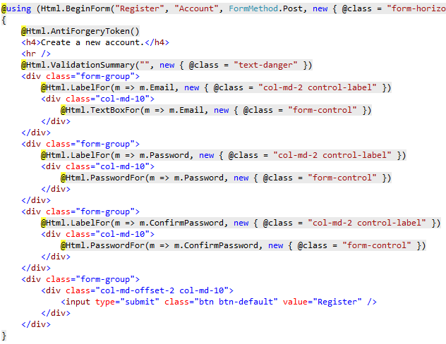
Tag Helpers vs HTML Helpers (2)

Slide 25

Creating Your Own Tag Helper
[HtmlTargetElement("h1")]
public class HelloTagHelper : TagHelper
{
private const string MessageFormat = "Hello, {0}";
public string TargetName { get; set; }
public override void Process(TagHelperContext context, TagHelperOutput output)
{
string formattedMessage = string.Format(MessageFormat, this.TargetName);
output.Content.SetContent(formattedMessage);
}
}
@using WebApplication;
@addTagHelper *, Microsoft.AspNetCore.Mvc.TagHelper
@addTagHelper WebApplication.TagHelpersHelloTagHelper, WebApplication
<div class="tag-helper-content">
<h1 target-name="John"></h1>
</div>

Slide 26

Partial Views & View Components

Slide 27
Partial Views
Partial Views render portions of a page
Break up large markup files into smaller components
Reduce the duplication of common view code
Razor partial views are normal views (.cshtml files)
Usually placed in /Shared/ or in the same directory where used
Can be referenced with HTML helper or Tag Helper
Html helpers: Partial, PartialAsync, RenderPartial, etc.
Tag helper: <partial name="" model="" view-data="" for="" />

Slide 28
Use of Partial Views
HTML Helper for Partial Views
Tag Helper for Partial Views
@using WebApplication.Models;
@model ProductsListViewModel
@foreach (var product in Model.Products)
{
@await Html.PartialAsync("_ProductPartial", product);
}
@foreach (var product in Model.Products)
{
<partial name="_ProductPartial" model="product" />
}

Slide 29


View Components (1)
View Components are similar to Partial Views but much more powerful
No model binding
Depend only on the data provided to it
View Components:
Render a chunk rather than a whole response (as in Html.Action())
Can have parameters and business logic
Is typically invoked from a Layout page
Includes the same S-o-C and testability benefits between controller / view

Slide 30
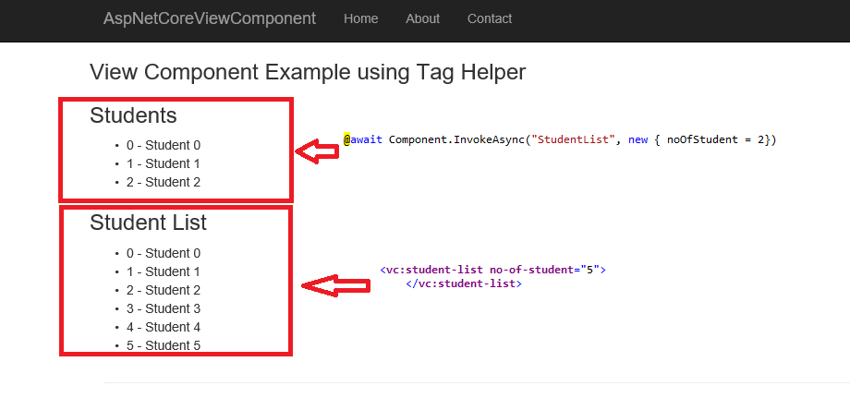
View Components (2)
View components are intended anywhere you have reusable rendering logic that's too complex for a partial view
Dynamic navigation menus
Login panels
Shopping carts
Sidebar content
Recently published articles
Tag cloud

Slide 31
View Components (3)
View Components consist of 2 parts:
A class – typically derived from ViewComponent
A result – typically a View
View Components
Define their logic in a method called InvokeAsync()
Never directly handle a Request
Typically initialize a Model which is passed to the View

Slide 32
Defining Your Own ViewComponent
[ViewComponent(Name = "HelloWorld")]
public class HelloWorldViewComponent : ViewComponent
{
private readonly DataService dataService;
public HelloWorldViewComponent(DataService dataService)
{
this.dataService = dataService;
}
public async Task<IViewComponentResult> InvokeAsync(string name)
{
string helloMessage = await this.dataService.GetHelloAsync();
this.ViewData["Message"] = helloMessage;
this.ViewData["Name"] = name;
return View();
}
}

Slide 33
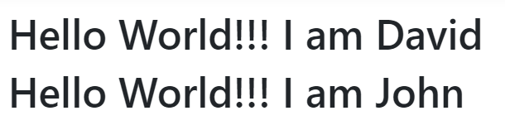
Defining Your Own ViewComponent
@* In Default.cshtml *@
<h1>@ViewData["Message"]!!! I am @ViewData["Name"]</h1>
<div class="view-component-content">
@await Component.InvokeAsync("HelloWorld", new { name = "David" });
<vc:HelloWorld name="John"></vc:HelloWorld>
</div>

Slide 34

Summary
Razor View Engine Essentials
Razor Syntax
Layout and Special Views
Sections
Tag Helpers & HTML Helpers
Partial Views & View Components
…
…
…

Slide 35
Questions?
Notes:
35

Slide 36













SoftUni Diamond Partners

Slide 37


Educational Partners

Slide 38
Trainings @ Software University (SoftUni)
Software University – High-Quality Education, Profession and Job for Software Developers
softuni.bg, softuni.org
Software University Foundation
softuni.foundation
Software University @ Facebook
facebook.com/SoftwareUniversity
Software University Forums
forum.softuni.bg
Notes:
38

Slide 39

License
This course (slides, examples, demos, exercises, homework, documents, videos and other assets) is copyrighted content
Unauthorized copy, reproduction or use is illegal
© SoftUni – https://softuni.org
© Software University – https://softuni.bg
Notes:
39

